Slide 1
Marketing Management
Dr. Rijul Chaturvedi

Slide 2
What is Marketing ?
Social Process
Organizational Function

Slide 3
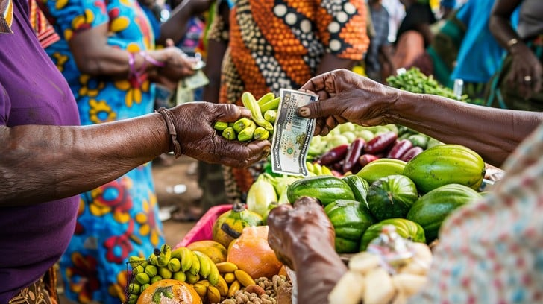
Exchange of Value
A Societal process by which individuals and groups obtain what they need and want through creating offering and freely exchanging products and services of value with others (Kotler et al., 2023).

Slide 4
Conditions for Exchange Potential
There Must be at least two parties
Each Party has something that might be of value to the other party
Each Party is capable of communication and delivery
Each party is free to accept or reject the exchange offer
Each party believe that it is appropriate or desirable to deal with the other party

Slide 5
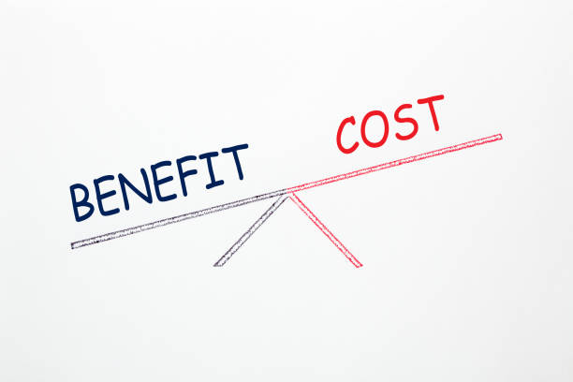
Value

Slide 6
Benefits :
  Emotional
  Functional
  Cost :
  Psychological
  Monetary
  Time
  Energy

Slide 7
Definition from American Marketing Association
Marketing is an organizational function and a set of process for creating, communicating, and delivering value to the customers and for managing customer relationships in ways that benefit the organization and its stakeholders

Slide 8


Slide 9
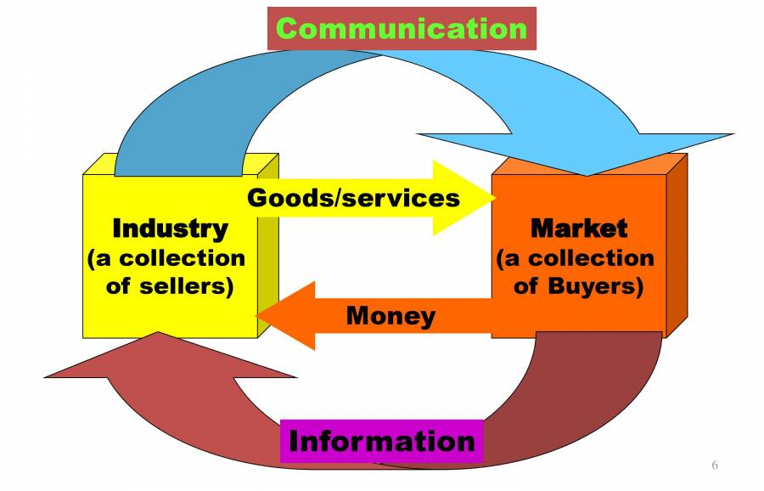
Simple Marketing System

Slide 10
Marketing Vs Sales
Sales oriented Process
Marketing Process
Produce
Sell
Create the Value
Communicate the Value
Deliver The Value

Slide 11
Core Concepts in Marketing
Need
Customer
Market
Product

Slide 12
Strategic Marketing Process
Business Analysis
Customer
Company
Competitor
Marketing Mix
Product
Price
Place
Promotion
Marketing Strategy
Segmentation
Targeting
Positioning

Slide 13
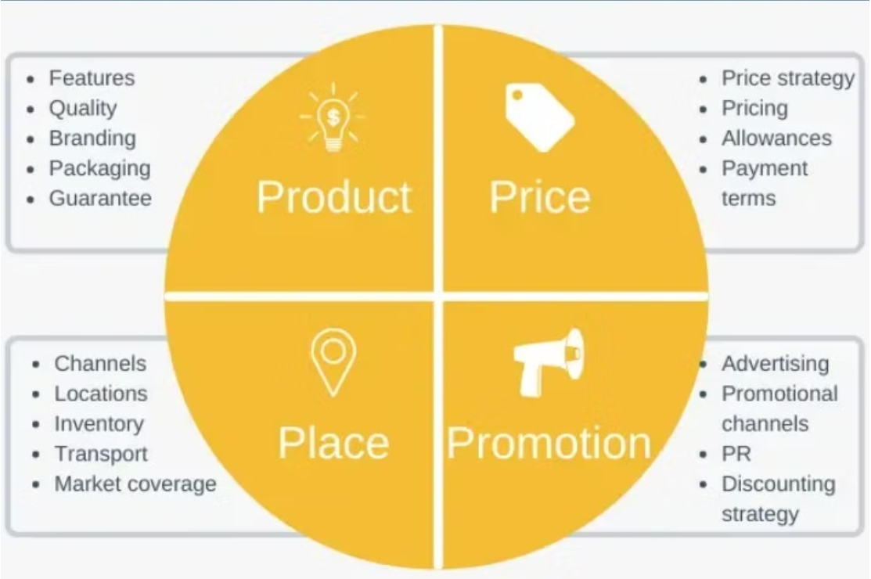

Slide 14
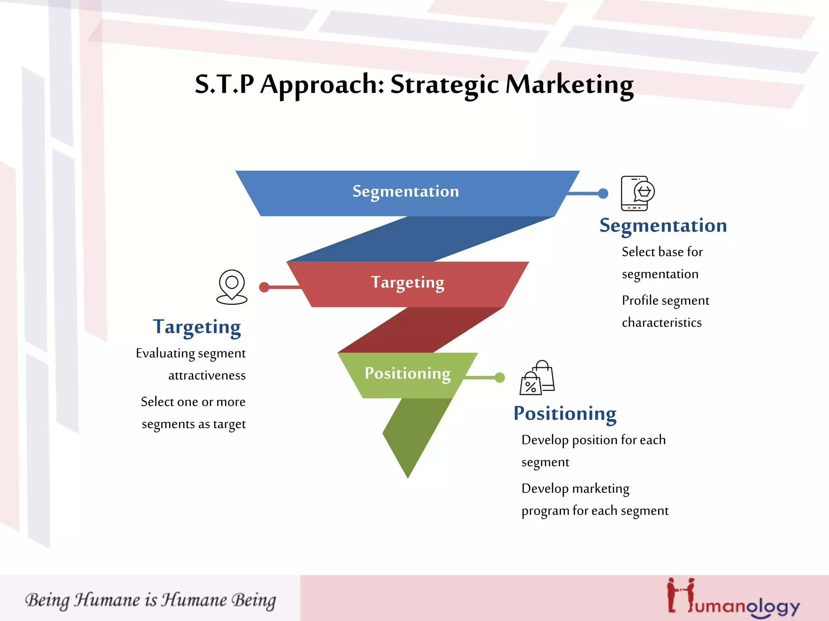

Slide 15
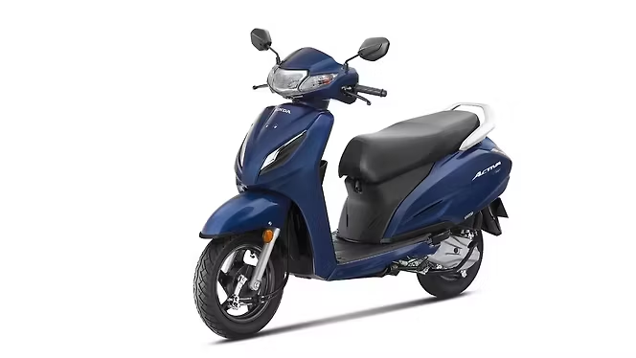
Success story of Honda Activa
Launched in June 2001
One of the Top Selling Two Wheler
Crossed Over one Crore sales mark

Slide 16
Sensing the Opportunity
Transportation Need of All Family Members
Indians Prefer Manageable Size Scooters
Traffic Congestion in the cities is rising
Limited parking space in traditional shopping areas
Low maintenance and comparable fuel economy

Slide 17
Honda Activa : Success ingredients
Attractive to both male and female
Easy handling: Engine Gearless and button start
Smaller in size as compare to a motorcycle
Lot of Storage Space (under the seat and front bucket)
Anti-theft Locking
Competitive Pricing

Slide 18
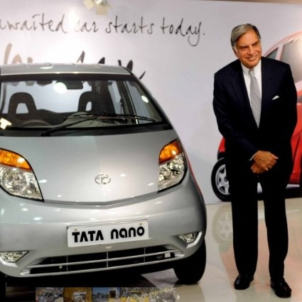
Tata Nano

Slide 19
Tata Nano : World’s cheapest Car
Launched in 2009 at price less than $2500
(original Target : Rs 1 Lakh)
To make Motoring available to masses in developing countries
Launched as People’s Car

Slide 20
“It (nano) became termed as a cheapest car by the public and, I am sorry to say, by ourselves, not by me, but the company when it was marketing it. I think that is unfortunate.”
(Ratan Tata, 28 Nov. 2013, CNBC)

Slide 21
Evolution of Marketing
Production Focus
Product Concept
Selling
Marketing
Holistic Marketing
Market Orientation

Slide 22
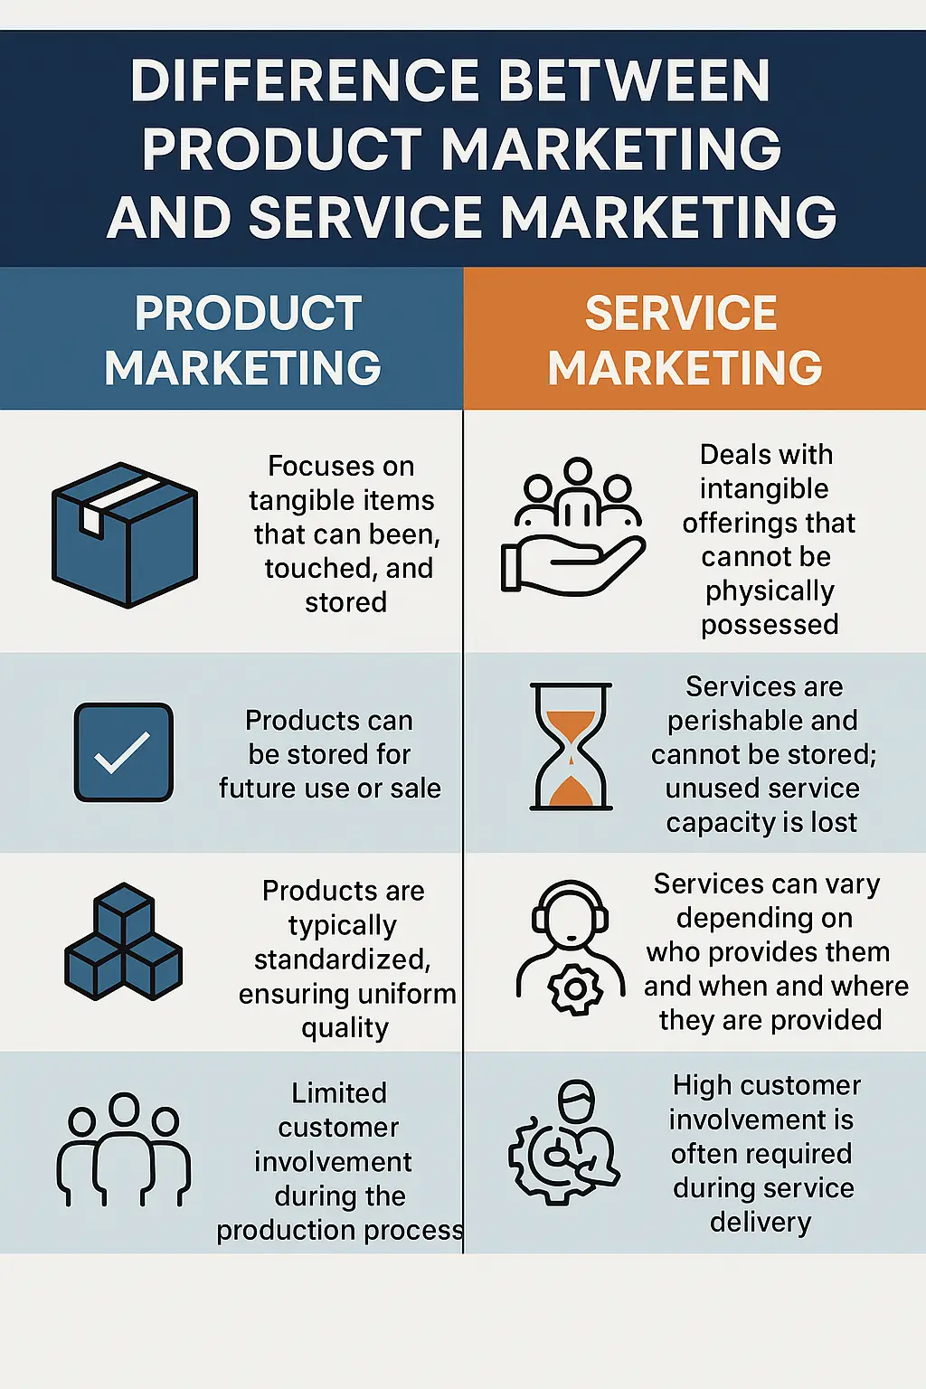

Slide 23
Marketing
"Marketing is the activity, set of institutions, and processes for creating, communicating, delivering, and exchanging offerings that have value for customers, clients, partners, and society at large." (Approved 2017)
Innovation
"An innovation is a new or improved product or process (or combination thereof) that differs significantly from the unit’s previous products or processes and that has been made available to potential users (product) or brought into use by the unit (process)."

Slide 24
“A business enterprise has two ad only two basic functions :
Marketing & Innovation”
- Peter Drucker

Slide 25
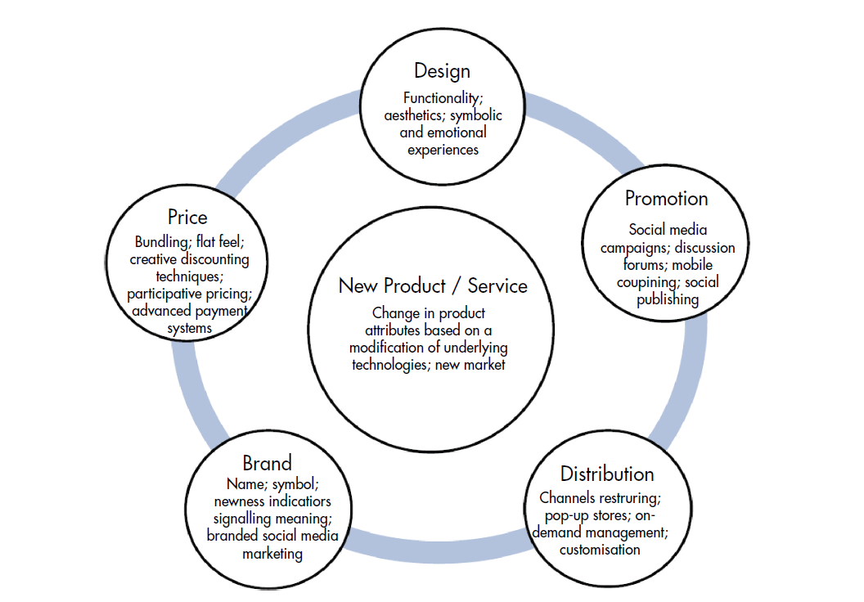

Slide 26

Innovation in Design
IKEA bright in design innovation by brining in their customers through co-creative activities and easily assembled furniture.

Slide 27
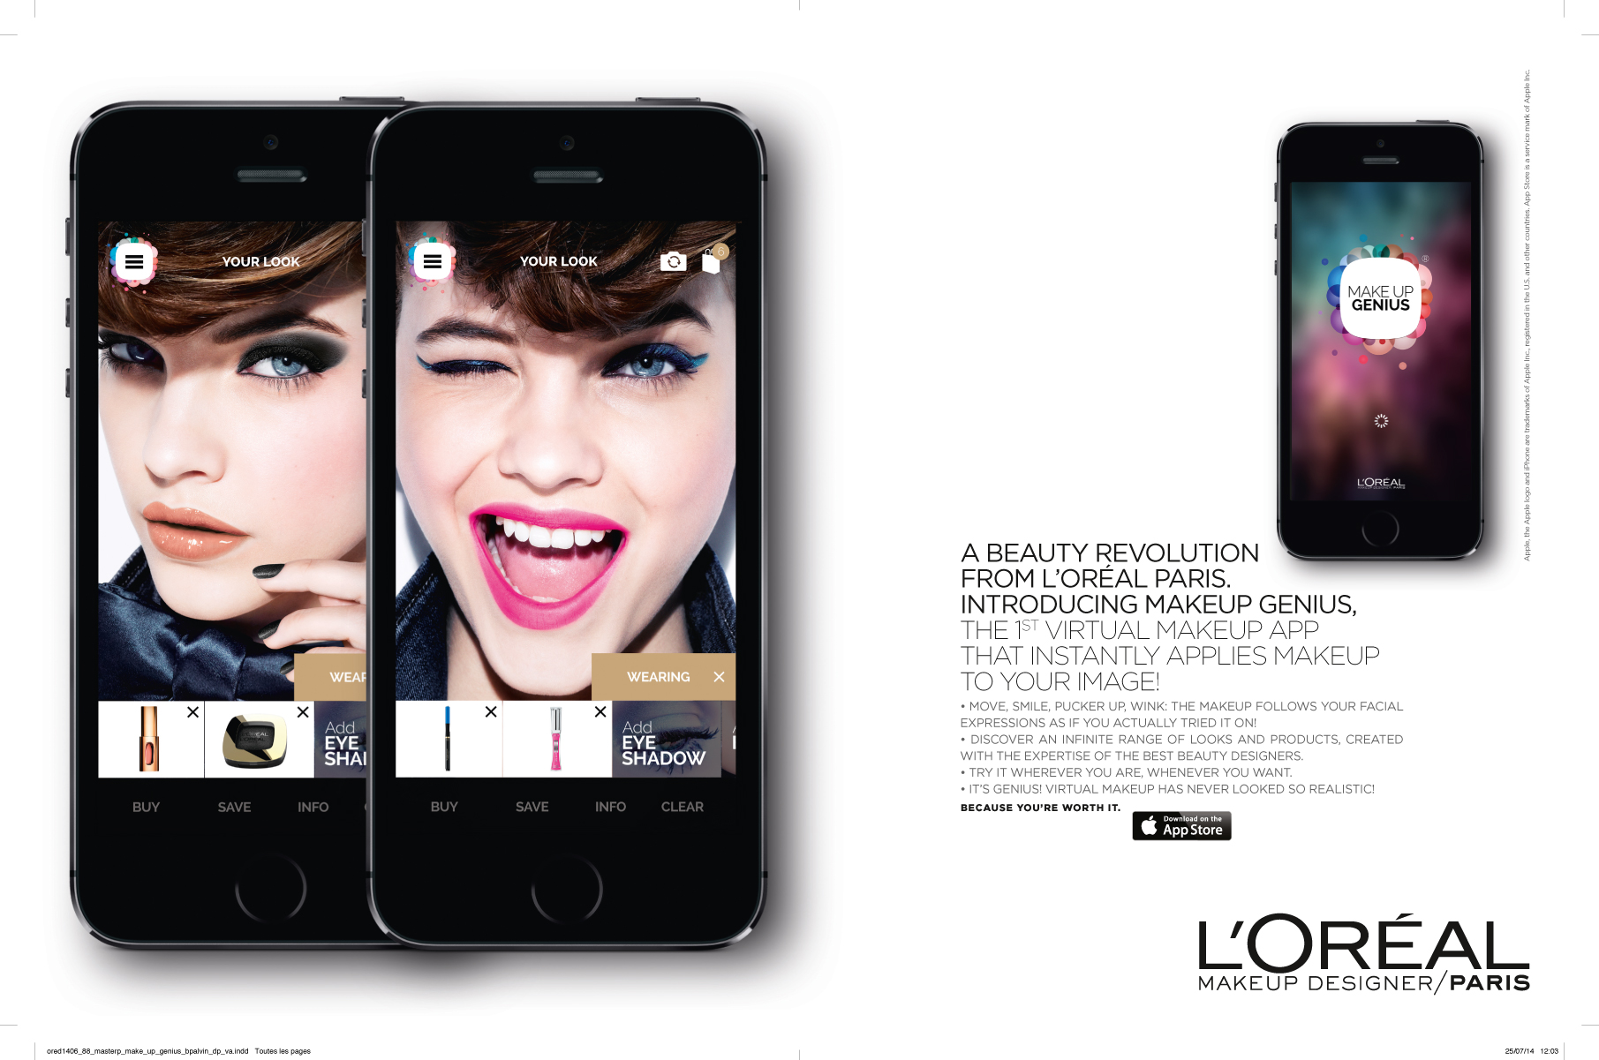
Innovation in Promotion

